Slide 1
JOB FRAUD PREDICTION EDA & MODELING
Presented By :
SAIKAT MAITY ( TNU2022053100038L)
ANAS RAHAMAN MOLLA (TNU2021053100033)
RITABAN GUCHAIT (TNU2021053100020)
SHOVAN BERA (TNU2021053100030)
ARINDAM PAKHIRA (TNU2021053100027)
Guidance By : DR. Usha Rani Gogoi

Slide 2

INTRODUCTION
This presentation explores the process of detecting fraudulent job postings using data analysis and machine learning models. We'll delve into the methodology employed, including Exploratory Data Analysis (EDA) and model selection, to effectively identify and mitigate this growing concern in the job market.

Slide 3
Problem Statement
Objective
Job fraud is a prevalent issue, with scammers creating fake job postings to deceive job seekers. Identifying and mitigating this type of fraud is crucial for protecting individuals and organizations.
This project aims to develop a model that effectively identifies fraudulent job postings based on various data features.

Slide 4
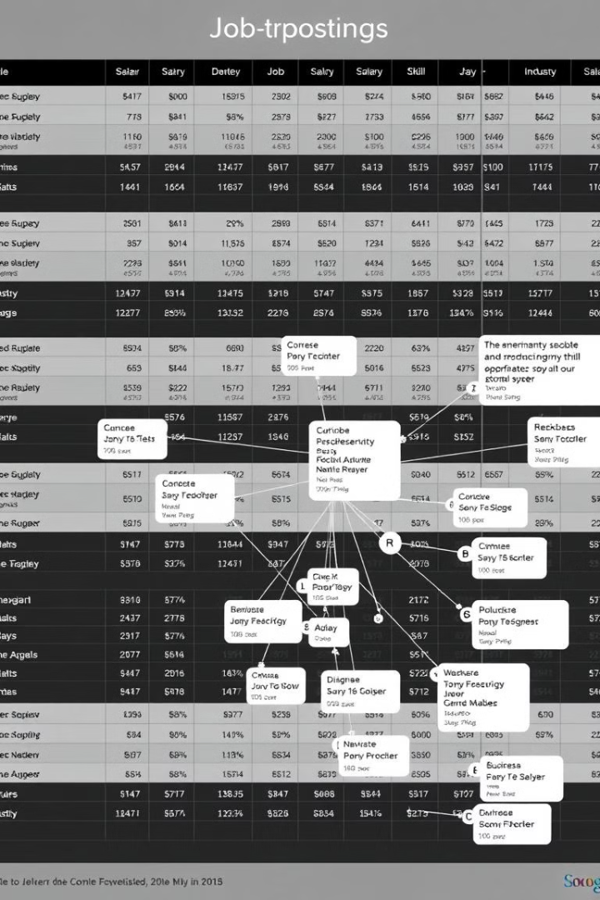
Dataset Exploration
Data Source
Data Features
The dataset used in this analysis is a collection of job postings from various platforms. It includes information on job titles, locations, descriptions, and other relevant attributes.
The dataset contains a wide array of features that can be used to identify fraudulent job postings, including keywords, grammar, and website domain information.
Data Cleaning
Prior to analysis, the dataset was cleaned and preprocessed to remove inconsistencies and irrelevant information.

Slide 5




Technology and Features
Text Preprocessing
Job descriptions were processed using techniques like stemming and stop word removal to extract meaningful keywords and patterns.
Domain Features
Domain information like website URLs and email addresses were analyzed to detect suspicious patterns associated with fraud.
Temporal Features
The time of posting and other temporal features were extracted to identify potential anomalies in job posting behavior.

Slide 6
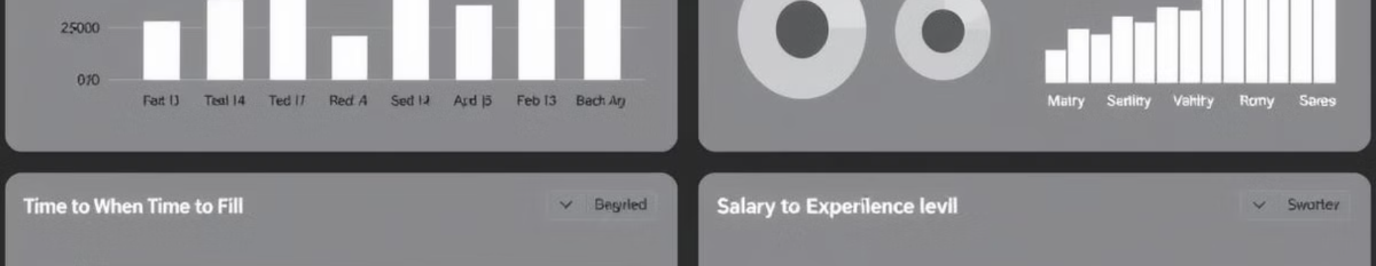
Exploratory Data Analysis
100
20%
50%
Suspicious Keywords
Grammar Errors
Domain Anomalies
The analysis revealed certain keywords frequently associated with fraudulent job postings.
Fraudulent postings often exhibited higher rates of grammatical errors compared to legitimate postings.
A significant portion of fraudulent postings were found to have suspicious website domains and email addresses.

Slide 7
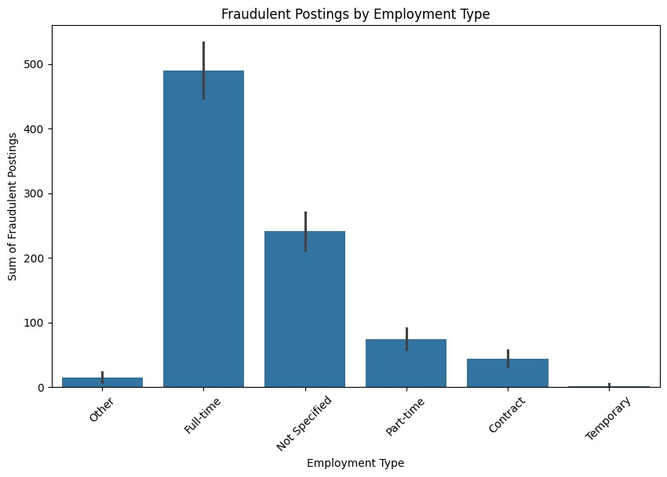
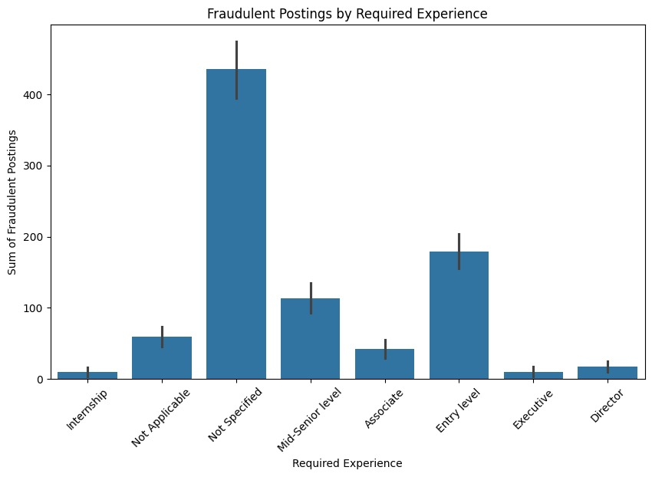
Data Visualization

Slide 8
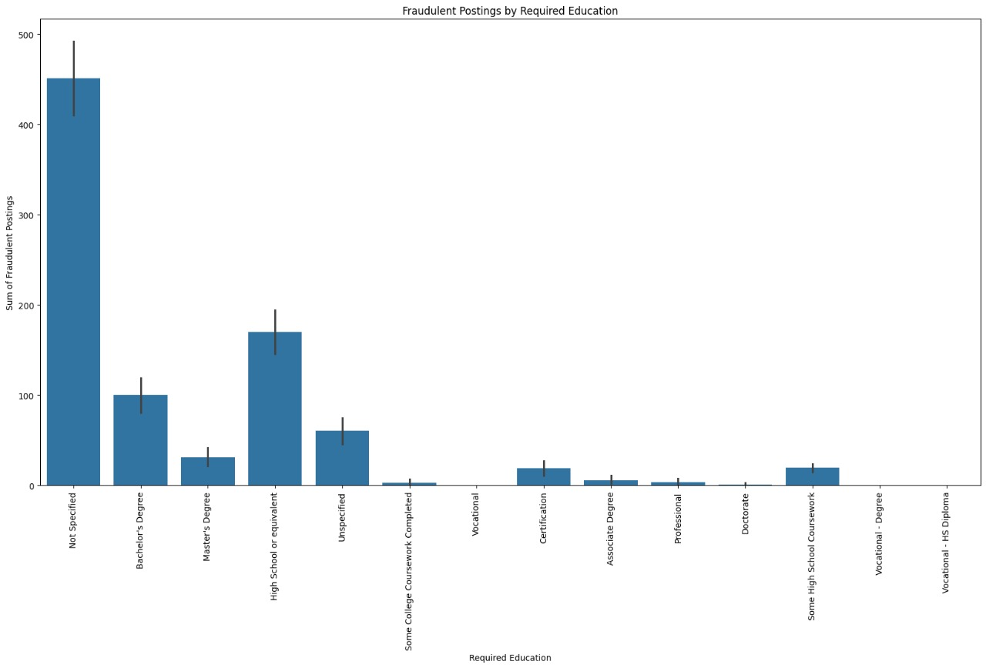

Slide 9
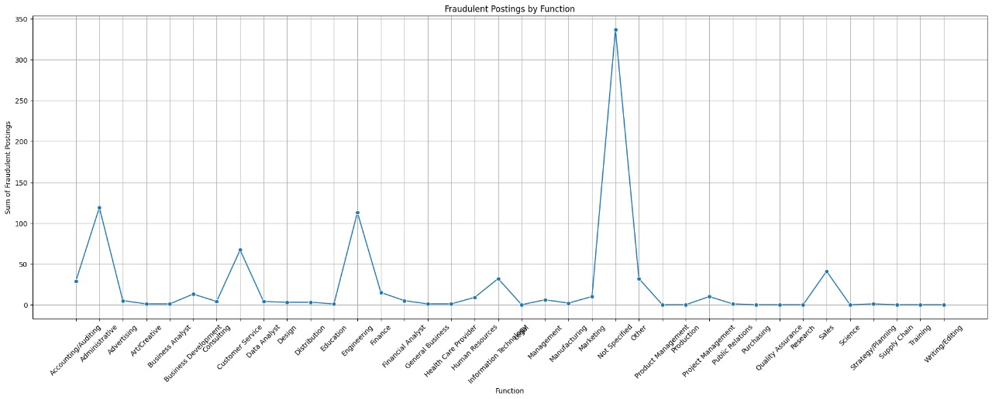

Slide 10
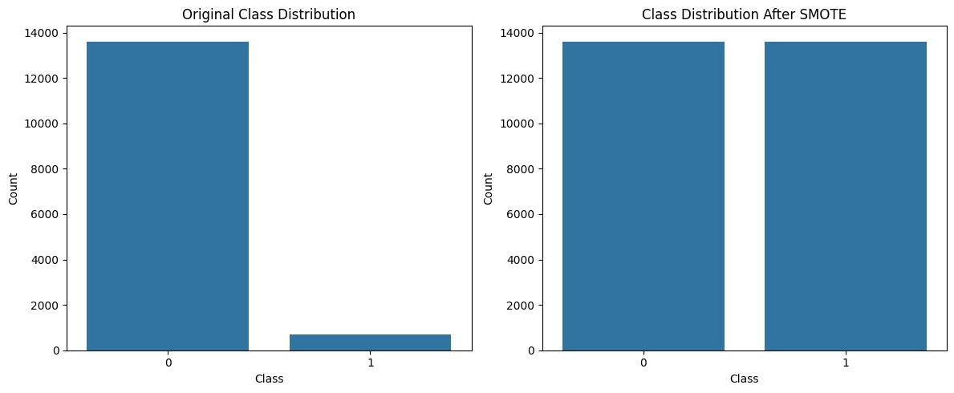

Slide 11
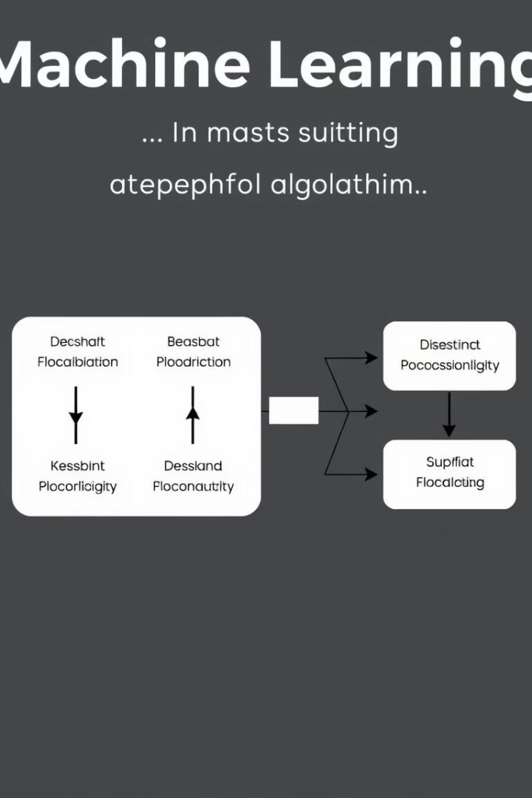



Model Selection
Machine Learning Models & Deep learning models
Several machine learning models were considered, including vectorization, Random Forest, , RNN Model, LSTM Model, GRU Model.
Evaluation Metrics
The models were evaluated based on metrics like accuracy, precision, recall, and F1-score.
Model Selection Criteria
The model with the highest performance on the evaluation metrics was chosen as the final model.

Slide 12
Model Evaluation
Performance Metrics
1
The selected model exhibited high accuracy and precision in identifying fraudulent job postings.
Model Tuning
2
The model was further tuned to optimize its performance and reduce the false positive rate.
Real-World Evaluation
3
The model was tested on a separate dataset of unseen job postings to assess its generalization capabilities.

Slide 13

Conclusions
The results of this project demonstrate the feasibility of using data analysis and machine learning to detect fraudulent job postings. The developed model can be integrated into job platforms to protect job seekers and enhance platform integrity.

Slide 14
Future Scope
✓ Collaboration with Industry:
• Partner with job portals and recruitment agencies to improve dataset
quality and integrate the model into real-world systems.
✓ Integration with Cybersecurity Tools:
• Combine job fraud detection with broader cybersecurity measures, such as phishing detection, for holistic protection.
References
https://www.kaggle.com/datasets/shivamb/real-or-fake-fake-jobposting-prediction/data
https://paperswithcode.com/dataset/fake

